Slide 1


Taller Xamarin Forms
@AsierTarancon
asiertarancon@gmail.com
www.azkoyen.com
www.riojadotnet.com

Slide 2
Disclaimer
La profesión de informática es dura.
Cambios constantes
No sólo de versiones, frameworks, tecnología.
En unos años han aparecido: IoT, BigData, Machine Learning, IA, Blockchain, Criptomonedas, realidad virtual/aumentada, Asistentes Digitales, Voice First…
Formación continua:
Formación reglada
Libros / Blogs / Twitter / Youtube…
Cursos online (Pluralsight, Coursera, Udemy)
Eventos técnicos
Eventos locales con Comunidades Locales

Slide 3

Rioja{dotnet} / Rioja Tech
www.riojadotnet.com
@RiojaDotNet
https://www.meetup.com/RiojaDotNet/
www.lariojatech.org
@TechRioja

Slide 4
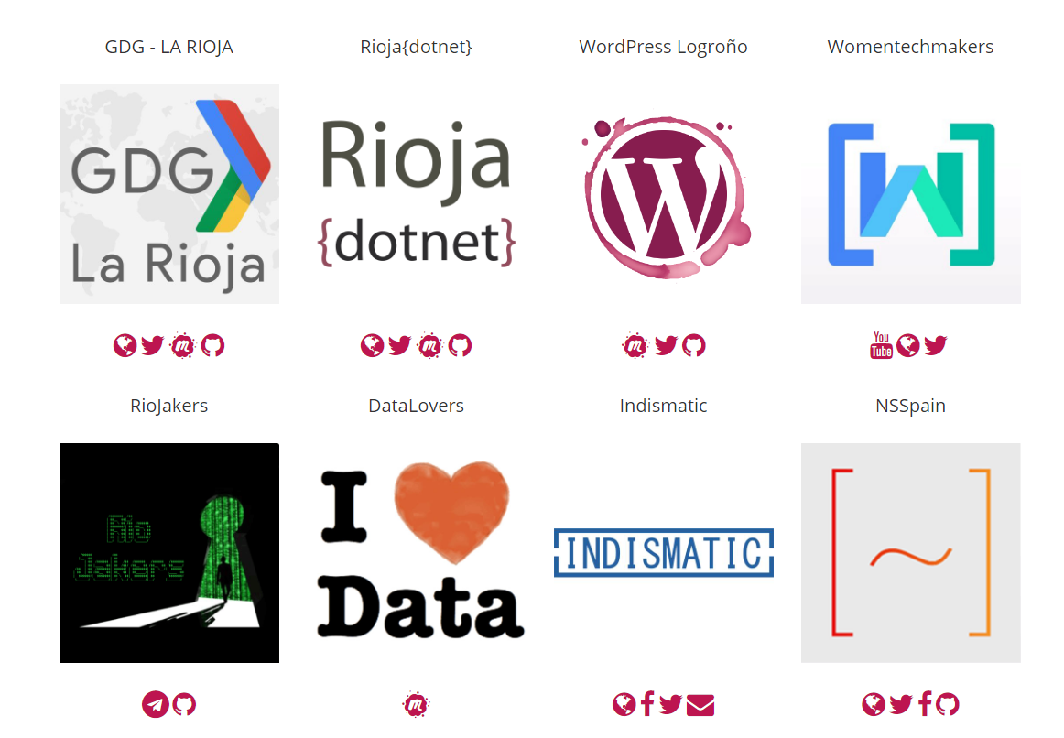
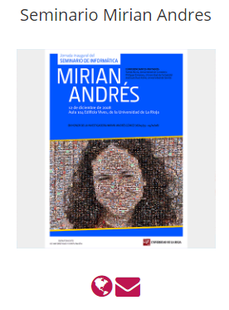

Slide 5
Objetivo del taller
Conocer el framework Xamarin Forms. Dónde encaja y posibilidades
Crear una aplicación multiplataforma (Android, iOS, …) con Xamarin Forms
Entender los pasos básicos. Punto de entrada, inicializaciones…
Comprender los distintos proyectos Android, iOS, de la solución
Crear páginas, utilizar los controles básicos…
MVVM, Binding
Uso de los nuevos componentes que vendrán en la próxima versión. Shell, Visual, CollectionView…
Y en 4 horas!

Slide 6
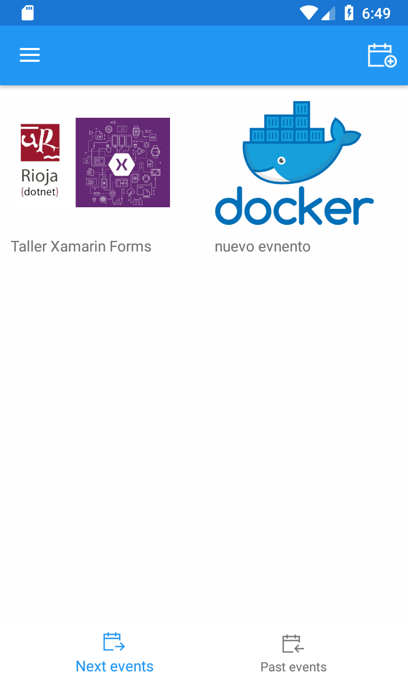
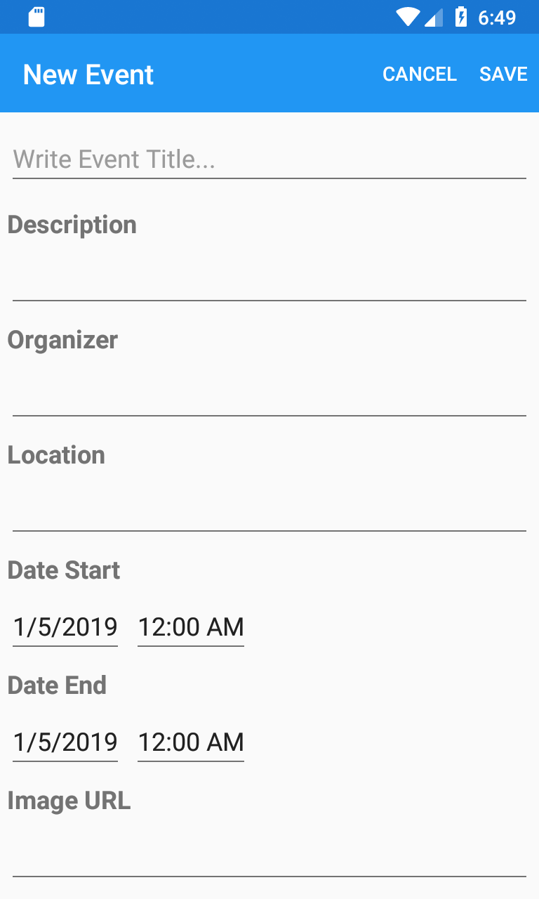
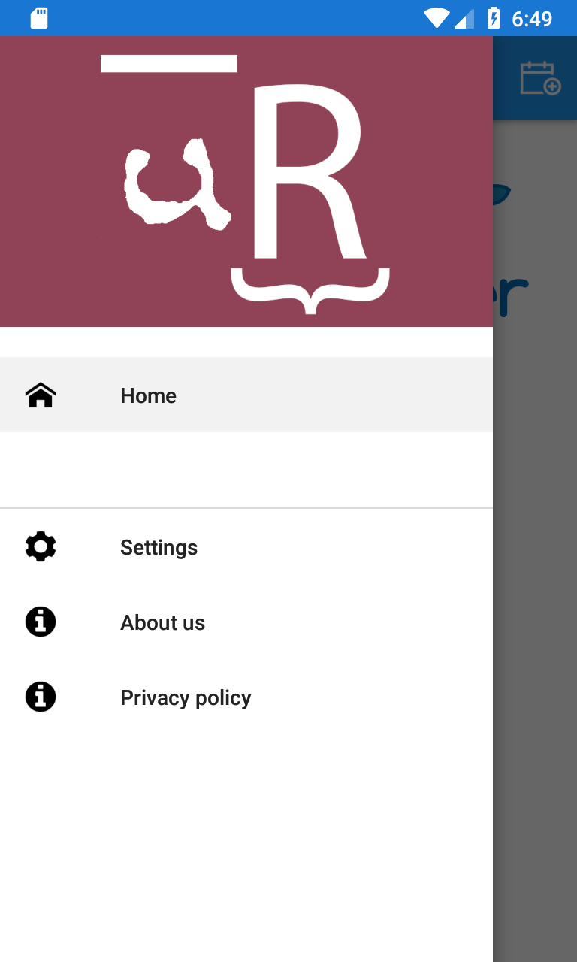
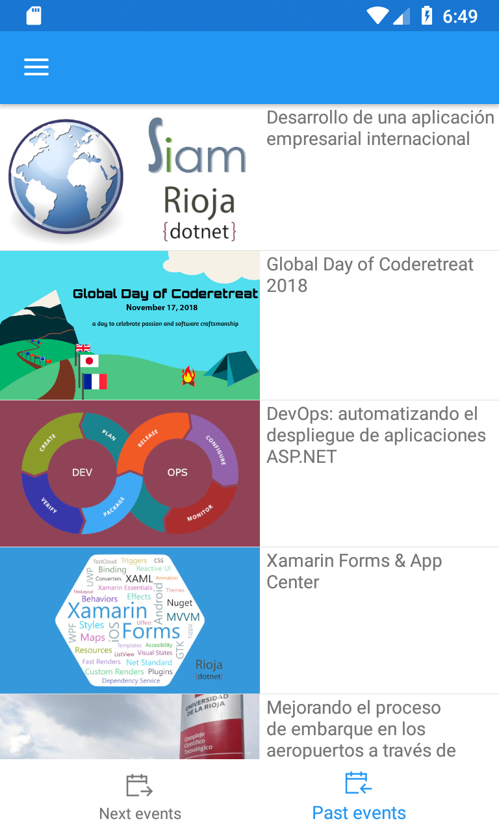
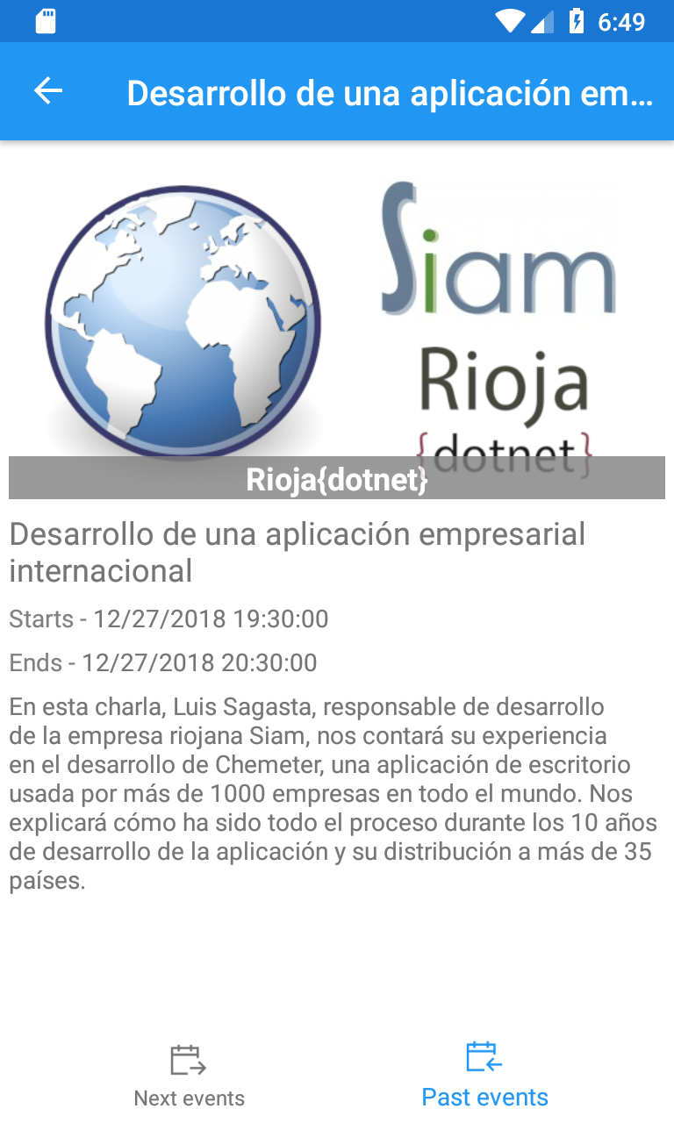
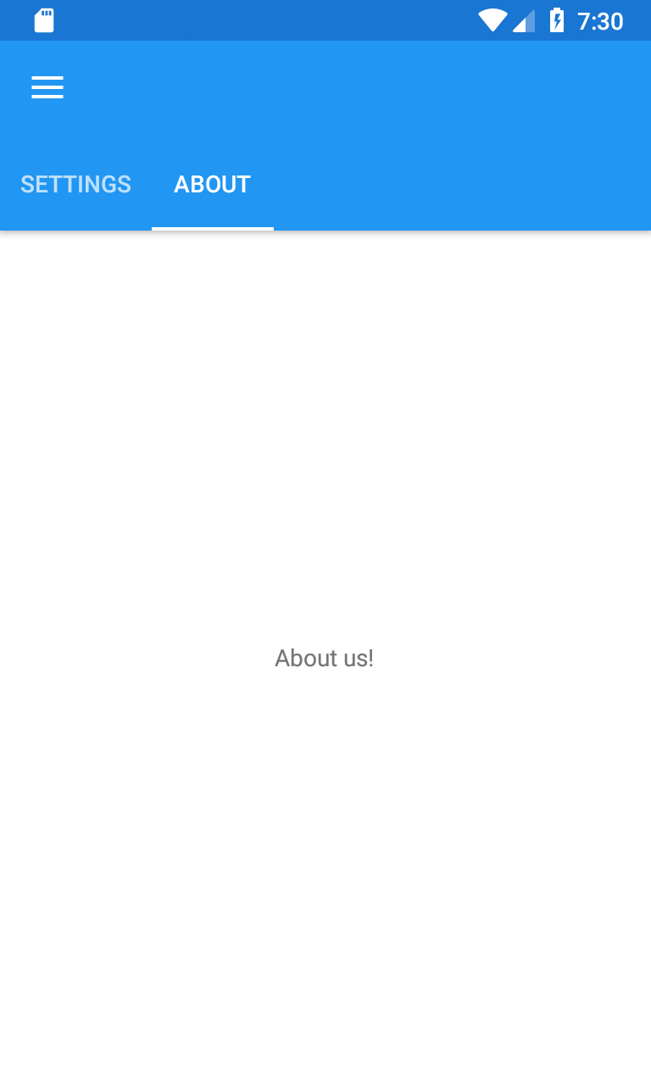

Slide 7
¿Qué vamos a ver?
Conceptos básicos de una solución Xamarin Forms con Visual Studio
¿Necesito un Mac?
Nuevo proyecto: XamaEvents
¿Por dónde empiezo? Punto de entrada a la aplicación
XAML / Namespaces
Controles
Binding / MVVM
Shell / Visual / CollectionView (preview)
Xamarin Essentials
¿Qué nos queda fuera?

Slide 8
¿Qué se queda fuera?
PLATFORM-SPECIFIC CODE
VIEWS (CONTROLES)
ESTILOS, RECURSOS, TEMAS
ANIMACIONES
LOCALIZATION
INYECCIÓN DE DEPENDENCIAS. LOCATOR
MAPAS
CONSUMING API REST
CUSTOM RENDERERS

Slide 9
¿Qué se queda fuera?
EFECTOS
BEHAVIORS
PERSISTENCIA
ACCESO AL HARDWARE DEL DISPOSITIVO
TESTS UNITARIOS
TESTS DE INTERFAZ
PERFORMANCE

Slide 10
BONUS (CURSO AVANZADO?)
VISUAL STUDIO TEAM SERVICES, GIT
APP CENTER.
ANALITICS
CI
NOTIFICACIONES PUSH
AZURE
SERVICIOS DE AUTENTICACIÓN
PUBLICACIÓN EN STORES

Slide 11
Paradigmas en el desarrollo móvil

Slide 12
¿Qué significa Nativo?

Slide 13
Native User Interfaces
Native API Access
Native Performance

Slide 14
Arquitectura Apps Móviles

Slide 15

Aplicación nativa
iOS
Android
Windows
Objective-C / Swift
Xcode
Java / Kotlin
Android Studio
C#
Visual Studio
No código compartido • Muchos lenguajes y entornos de desarrollo• Múltiples equipos

Slide 16
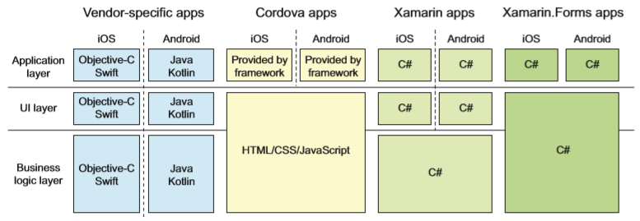

Slide 17
Hybrid approach
Lua
Javascript
Actionscript
HTML+CSS
App generator
Acceso API native limitado • Lento rendimiento • Pobre experiencia de usuario
Notes:
The next approach is the hybrid approach, also known as “Write Once, Run Anywhere”. Think of solutions like PhoneGap and Ionic. These frameworks mostly allow developers to start off relatively easy, because they are based on web technology. So, you can start writing your app very quickly using HTML and JavaScript or Lua, etc. Figure 1-4 illustrates this concept
This way of developing means that you are mostly limited to the APIs that are the common denominator on all platforms. Each phone has a camera nowadays, so that is supported. Not all phones have augmented reality features, so to support that from day one, you have to write Java or Objective-C code. Also, the render time tends to be slower. Even worse, when your CSS fails to load, your user is presented with an ugly app, leaving them puzzled.
Most of the time, hybrid apps also look the same across all platforms. While that seems convenient from a developer’s perspective, from a user perspective, it is not. I will elaborate more on that in a minute when I explain the Xamarin approach. All in all, the hybrid approach seems to cause more misery than anything else. In all fairness, I haven’t touched any hybrid development solutions in-depth. But I can usually pick out the hybrid apps from the store, and not in a good way. All of this raises the question: what is native? We often hear that native apps are best. But what does native mean? That is what the people at Xamarin asked themselves before setting out on their journey. They came up with the following characteristics:
• Looks and feels like it belongs on that platform. The app should adopt the paradigm of the platform it’s running on. Adhere to the navigation pattern, have controls that the user is used to from other apps, and so on. Remember when I spoke of the generic look and user experience for apps with the hybrid approach? That is what you want to avoid. When the look and feel does not comply with the rest of the ecosystem, the user will be confused.
• 100% API access. The developer should have access to all of the APIs that are available on that platform. No exceptions. When some new awesome feature is announced for the new iOS, you must be able to use it in your app. And not just the Apple or Google APIs either, you must also be able to use any third-party API and library out there.
• Provides the best performance. It must provide the best performance. Although it may not be the native programming language, the app still must be responsive and fast.
These days, users have high expectations! When your app is not doing what it should, it is usually uninstalled within 30 seconds and it will be really hard to convince the user to come back after that. So, these statements about what is native are important. With that in mind, Xamarin came up with their own approach to things, as shown in Figure 1-5.

Slide 18
React Native
Programas en JavaScript (React)
Convierte el código a nativo
Permite LiveReload, ver el resultado de forma simultánea mientras desarrollas.
https://facebook.github.io/react-native/docs/getting-started

Slide 19
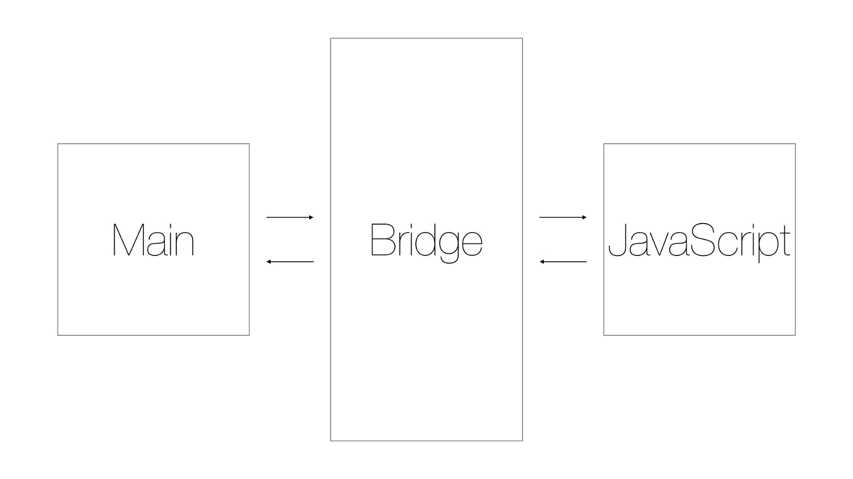
React Native

Slide 20
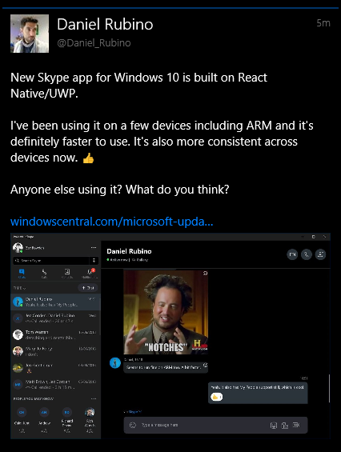

React Native
https://medium.com/airbnb-engineering/react-native-at-airbnb-f95aa460be1c
https://www.windowscentral.com/microsoft-updating-its-skype-app-windows-10-new-design-and-more

Slide 21
Flutter (Google)
Flutter pinta los controles en cada plataforma.
Free and Open Source
“In addition, Flutter is different because it only has a thin layer of C/C++ code. Flutter implements most of its system (compositing, gestures, animation, framework, widgets, etc) in Dart (a modern, terse, object-oriented language) that developers can easily approach read, change, replace, or remove. “
https://flutter.io/faq/#what-does-flutter-do
“Sólo” Android y iOS. No UWP.
Acaba de salir la versión Release Preview 1 Realease 1.0

Slide 22
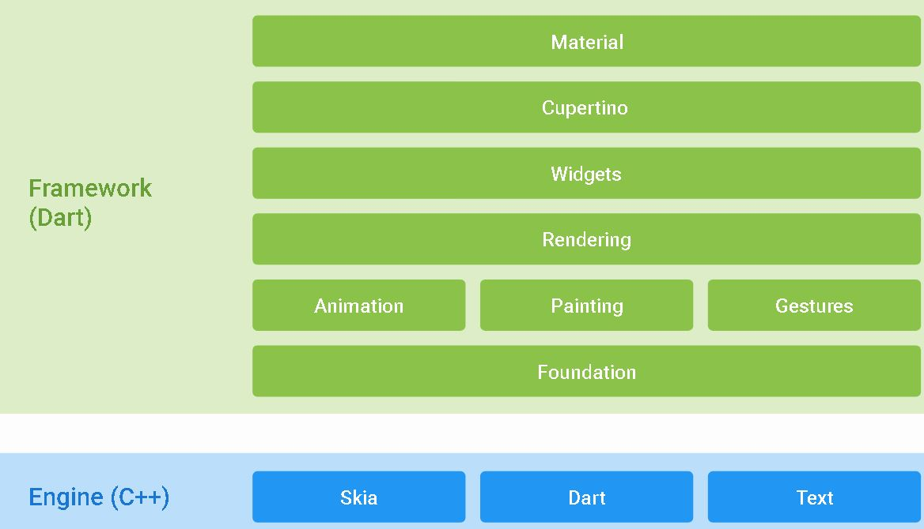

Slide 23
Aproximación Xamarin
iOS UI
Android UI
Windows UI
Lógica compartida C#
Código base compartido C# • 100% acceso API nativo • Alto rendimiento
Notes:
Xamarin basically created mappings for all native APIs and made them available through C# and .NET. In fact, it makes perfect sense, because Microsoft has been doing this for years. Whenever you started a WinForms project, you would get the base .NET Framework libraries, with a set specific to WinForms as an addition. Planning on an ASP.NET application? You get the same set of base libraries and a specific set to ASP.NET. The team at Xamarin created so-called projections. Each method, object, property, etc. that is available in Objective-C of Java Xamarin is available in .NET with its own types. That way everything is available to the developers, most of the time from day one.
Especially for iOS, Xamarin has an unbeaten track record since iOS 5. The day that Apple releases the new (final) iOS version, Xamarin has updated their bits, and everything is available to you as well. For iOS, this is important, because the adoption rate on a new iOS version is quite high. On Android, not so much. Months after an update is released, people are still stuck on the older version. So, the same-day support isn’t as relevant. That does not mean that Xamarin is lacking with adding new APIs. Although it may not be the same day, it is soon after release. If you miss anything, like support for some third-party library, Xamarin has you covered. The tools that are used internally to create the projections are available to you as well. That way, you can create your own binding library for a native API if you want to. The statement Xamarin has always carried out is the following: “Anything you can do in Objective-C, Swift, or Java can be done in C# and Visual Studio with Xamarin.”
I still haven’t found anything to counter that statement. When Microsoft took over, things went a step further. With developments like .NET Core and .NET Standard, cross-platform development is looking better than ever before. This enables developers to develop code that is truly useable across platforms. In Figure 1-6, you can see an example of that.

Slide 24
HISTORIA DE XAMARIN
1999- Ximian. Miguel de Icaza y Nat Friedman
GNOME. Desktop environment for UNIX-based systems
2000- Microsoft announced .NET Framework
2001- Nace Mono.
Objetivo: Hacer funcionar una app .Net en otras plataformas
2003- Novell compra Ximian
2004- Mono 1.0
2005- .NET Framework 2.0
Ese Microsoft no era el de ahora, no le gustaba el proyecto “open source”
2009- Lanzan MonoTouch y MonoDroid
Notes:
Xamarin.Forms is only a small part of the greater solution that is called Xamarin. Xamarin is both the name of the technique and the name of the company that is behind it. But before it became the company as we know it, there has been a lot going on. It all started with Miguel de Icaza and Nat Friedman, both still heavily involved. They founded a company together in 1999, which eventually will be known as Ximian. At that time, they were focused on developing GNOME, which is a desktop environment for Unix-based systems. Soon after Microsoft announced the .NET Framework in June 2000, Miguel started investigating whether a Linux counterpart would be possible. This led to the launch of the Mono project in July 2001. This open source project is basically the foundation of Xamarin. Back in 2001, the goal was set to run .NET Framework applications on other platforms. In 2003, Novell acquired Ximian, along with the Mono project. Novell was known for being one of the first companies that facilitated thin clients, by being able to run applications on the server. The acquisition of Ximian was the start of transitioning their product suite to a Linux base. After three years of development, major version 1.0 of the Mono project was released in 2004. This was only a year before Microsoft released version 2.0 of the .NET Framework. As you may recall, Microsoft did not support the open source idea back then. Because of that, support for Mono would always be behind the implementation of Microsoft, and as time passed, this gap was quickly closed. However, some form of collaboration happened and was further expanded in 2006. During the time that Ximian was under the care of Novell, Mono did not live up to its potential. After a lot of hard work in 2009, Mono Touch, the foundation of Xamarin as a technology, was released. With the release of Mono Touch 1.0, C# applications could be submitted to the iOS app store. Actually, at some point around the iOS 4 release in 2010, there was a little dispute on Apple banning Mono Touch applications (along with Flash) from the app store. Apple updated their license agreement with:
“Applications may only use documented APIs in the manner prescribed by Apple and must not use or call any private APIs. Applications must be originally written in Objective-C, C, C++, or JavaScript as executed by the iPhone OS WebKit engine, and only code written in C, C++, and Objective-C may compile and directly link against the documented APIs (e.g., applications that link to documented APIs through an intermediary translation or compatibility layer or tool are prohibited).”
This meant that all cross-compiled apps would not be allowed, including Mono Touch applications. The main reason would be that Apple would lose control over the ecosystem they had created. After a lot of
criticism, the rules were toned down a little, allowing other programming languages to be used. However, as a side note, you still need Mac hardware to compile your iOS applications. Also in 2010, Novell was acquired by a company called Attachmate. In April 2011, most of the Novell team was laid off. This begged the question of what would happen to the Mono project. And more importantly for mobile developers, what would happen to the Mono Touch project. Soon after the layoffs, in a blog post, Miguel announced that Mono would find continuation in a newly founded company called Xamarin. Nat Friedman was appointed the CEO of Xamarin soon after. If you have ever wondered where the name Xamarin came from, consider what Miguel de Icaza said in an interview with adtmag.com: (see https://adtmag.com/blogs/watersworks/2011/05/interviewwith- miguel-de-icaza.aspx): “We've used monkey themes for many years,” de Icaza said. “Ximian was a play on simian. Mono is Spanish for monkey. Xamarin comes from the Tamarin monkey. And we kept the X; though to tell you the truth, I can't remember why we used it in the first place.”

Slide 25
Abril 2011- Attachmate compra Novell
Despide a cientos de trabajadores, incluyendo desarrolladores de Mono
¿futuro?
Mayo 2011- Miguel de Icaza anuncia Xamarin
Desarrollo y soporte de Mono
Lanzará una serie de productos para dispositivos móviles
Parte del equipo original es movido a la nueva compañía
Novell otorga una licencia perpetua a Xamarin sobre Mono, MonoTouch y Mono Android
Como curiosidad. Xamarin viene de:
X. (Ximian)
Amarin (Tamarin Monkey)

Slide 26
HISTORIA DE XAMARIN
2012- Lanzan Xamarin.Mac
2012- Soportan Windows Phone
2013- Lanzan Xamarin.IOS y Xamarin.Android
2013- Lanzan Xamarin Studio (IDE)
Microsoft empieza a cambiar su forma de ser.
Mucho Open Source
Mucho Github
Lanzan UWP -> permiten sus “Aplicaciones Universales”
2016- Microsoft adquiere Xamarin
2016- Microsoft adquiere Hockey APP
Notes:
Xamarin Today
The rest is history, as they say. From the launch of Xamarin as a company, things started to accelerate. In 2012 and 2013, it went a bit silent, but Xamarin introduced their flagship products. Xamarin.Mac, released in December 2012, enabled developers to write C# applications for the MacOS desktop. In February 2013, Xamarin.iOS and Xamarin.Android were released. At this time, developers could share code between iOS, Android, and MacOS. Implicitly Windows Phone, released in October of 2012, was supported as well, because this was already based on C# and .NET technology. Along with the Xamarin framework, Xamarin Studio was also released. This Integrated Development Environment (IDE) would be the choice for developing Xamarin cross-platform apps for several years to come.
In the meantime, Microsoft was changing course rapidly as well. A lot of the .NET projects were converted to open source and put on GitHub. Windows Phone was still being maintained, but the future of it seems unsure. Certainly, with the introduction of Universal Windows Platform (UWP) apps, it is now possible to run your app on any Windows-based device, including but not limited to Xbox, HoloLens, Windows Phone, and Windows 10 desktop. In February 2016, the whole Xamarin crew became part of Microsoft. Not long after that, more good news was in store. At the Build conference, Microsoft announced that the Xamarin development tools would be free and become open source as well. With the acquisition of Xamarin, Microsoft is a contender in the mobile market. Before, they had a hard time gaining some market share with the Windows Phone, but now they have a full end-to-end C# solution for developing applications. And not just developing! In December 2014, Microsoft bought HockeyApp, a solution for crash reporting, analytics, and distribution of mobile apps. HockeyApp, Xamarin, and what Microsoft already had in their portfolio combined, makes them the most complete vendor for everything mobile to date as far as I am concerned. As to be expected, some Xamarin branded components are being replaced slowly by the Microsoft brand. Xamarin Studio is now Visual Studio for Mac with more Azure options; the Xamarin MVP program is fused with the Microsoft MVP program; etc. But I think it will take a while before the name Xamarin will disappear completely, at least at the company level. But it doesn’t stop at rebranding. Microsoft is also putting a lot of effort into bringing all the acquired solutions together and introduced Mobile Center in November 2016. This user-friendly environment combines all the best parts of Visual Studio Team Services (VSTS), Xamarin Test Cloud, and HockeyApp, as well as some parts of Azure relevant to mobile into a single point of entry. While still in preview at the time of writing, there is a lot you can do already. Just before the release of this book Microsoft has taken Mobile Center out of preview. It is now called App Center. Where
Chapter

Slide 27
HISTORIA DE XAMARIN
Empieza el renombrado de marca
Xamarin Studio -> Visual Studio for MAC
Hockey APP -> Es absorbido por VSTS y Mobile Center
Xamarin MVP -> Microsoft MVP
Aunque Xamarin seguirá existiendo como marca y línea de productos
Xamarin Platform
Xamarin Forms
Xamarin Test Cloud
Visual Studio for Mac (Xamarin Studio)
Xamarin for Visual Studio
Xamarin Profiler
Xamarin Workbooks

Slide 28
Xamarin
Liberan el código fuente (Licencia MIT)
Xamarin.iOS
Xamarin.Mac
Xamarin.Android
Xamarin.Forms
Bindings & Plugins
Gratis
Como plataforma
Herramientas gratuitas de desarrollo

Slide 29
¿Cómo funciona Xamarin?

Slide 30
Windows APIs
Microsoft.Phone
Microsoft.Networking
Windows.Storage
Windows.Foundation
Microsoft.Devices
System.Net
System
System.IO
System.Linq
System.Xml
System.Data
System.Windows
System.Numerics
System.Core
System.ServiceModel
C#

Slide 31
iOS – 100% API coverage
MapKit
UIKit
iBeacon
CoreGraphics
CoreMotion
System.Net
System
System.IO
System.Linq
System.Xml
System.Data
System.Windows
System.Numerics
System.Core
System.ServiceModel
C#

Slide 32
Android – 100% API coverage
Text-to-speech
ActionBar
Printing Framework
Renderscript
NFC
System.Net
System
System.IO
System.Linq
System.Xml
System.Data
System.Windows
System.Numerics
System.Core
System.ServiceModel
C#

Slide 33
Xamarin Forms

Slide 34
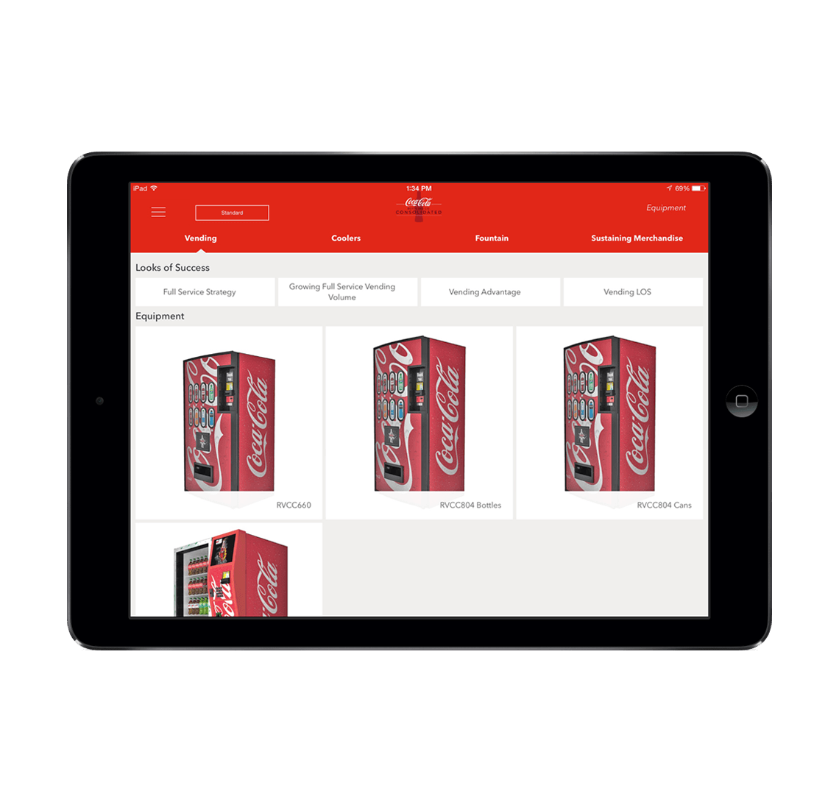
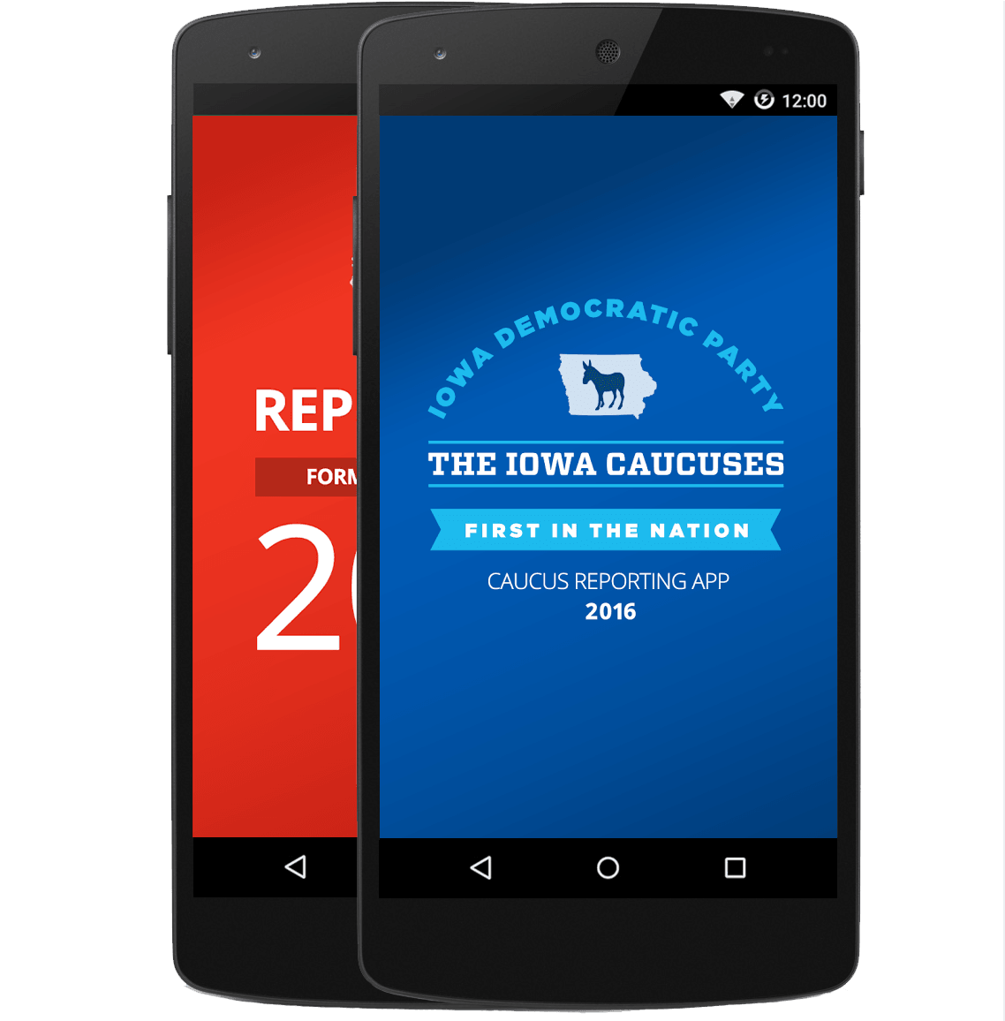
Xamarin.Forms- Cross Platform UI
Código UI compartido
Lógica C# compartido
Interfaz Usuario nativa compartida
Lógica compartida C#

Slide 35
¿Qué incluye?
✓ 40+ Páginas, diseños, y controles
(code behind o XAML)
✓ Enlace a datos (doble vía)
✓ Navegación
✓ API Animaciones
✓ Servicio Dependencia
✓ Centro de Mensajes
UI Compartida
Lógica compartida C#

Slide 36

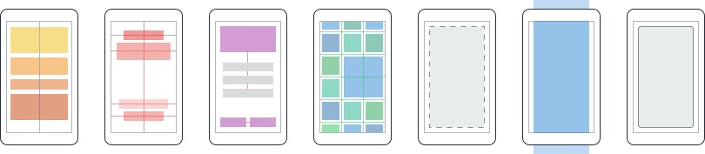
Layouts
Pages
Content
MasterDetail
Navigation
Tabbed
Carousel
Stack
Absolute
Relative
Grid
ContentView
ScrollView
Frame

Slide 37
Controls
ActivityIndicator
BoxView
Button
DatePicker
Editor
Entry
Image
Label
ListView
Map
OpenGLView
Picker
ProgressBar
SearchBar
Slider
Stepper
TableView
TimePicker
WebView
EntryCell
ImageCell
SwitchCell
TextCell
ViewCell
CollectionView

Slide 38
Native UI
Forms elements are realized via platform renderers.
 | ContentPage | Label | Picker
Android | Activity / Fragment | TextView | AlertDialog + LinearLayout + EditText + NumberPicker
iOS | UIViewController | UILabel | UITextField + UIPickerView + UIToolbar + UIBarButtonItem
UWP | Page | TextBlock | ComboBox
developer.xamarin.com/guides/xamarin-forms/application-fundamentals/custom-renderer/renderers/

Slide 39
Rendimiento Nativo
ARM BINARY
IL + JIT
.NET
.NET
AOT
.APP
Compile and Link
.APK
C#
C#
Runs natively
Runs natively
Bindings
Bindings
Xamarin.iOS. Hace compilación Ahead Of Time (AOT) para producir un binario ARM para la App Store de Apple
Xamarin.Android utiliza compilación Just In Time (JIT) en dispositivos Android.

Slide 40
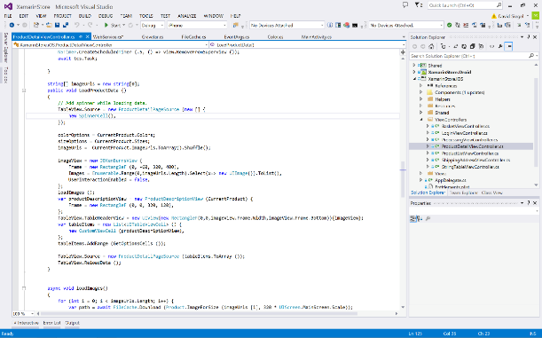
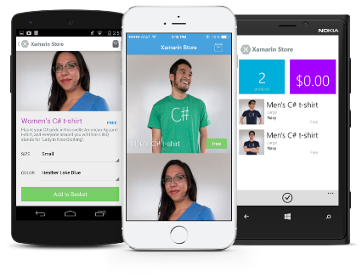
Todo lo que puedes hacer en Objetive-C, Swift, o Java se puede hacer en C# con Xamarin

Slide 41
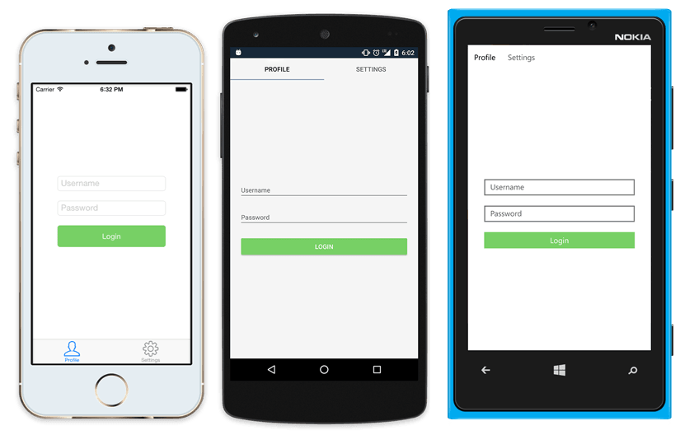
UI Nativo desde código compartido
<?xml version="1.0" encoding="UTF-8"?>
<TabbedPage xmlns="http://xamarin.com/schemas/2014/forms"
xmlns:x="http://schemas.microsoft.com/winfx/2009/xaml"
x:Class="MyApp.MainPage">
<TabbedPage.Children>
<ContentPage Title="Profile" Icon="Profile.png">
<StackLayout Spacing="20" Padding="20“ VerticalOptions="Center">
<Entry Placeholder="Username, Text="{Binding Username}"/>
<Entry Placeholder="Password” Text="{Binding Password}“ IsPassword="true"/>
<Button Text="Login" TextColor="White“ BackgroundColor="#77D065"
Command="{Binding LoginCommand}"/>
</StackLayout>
</ContentPage>
<ContentPage Title="Settings" Icon="Settings.png">
<!-- Settings -->
</ContentPage>
</TabbedPage.Children>
</TabbedPage>

Slide 42
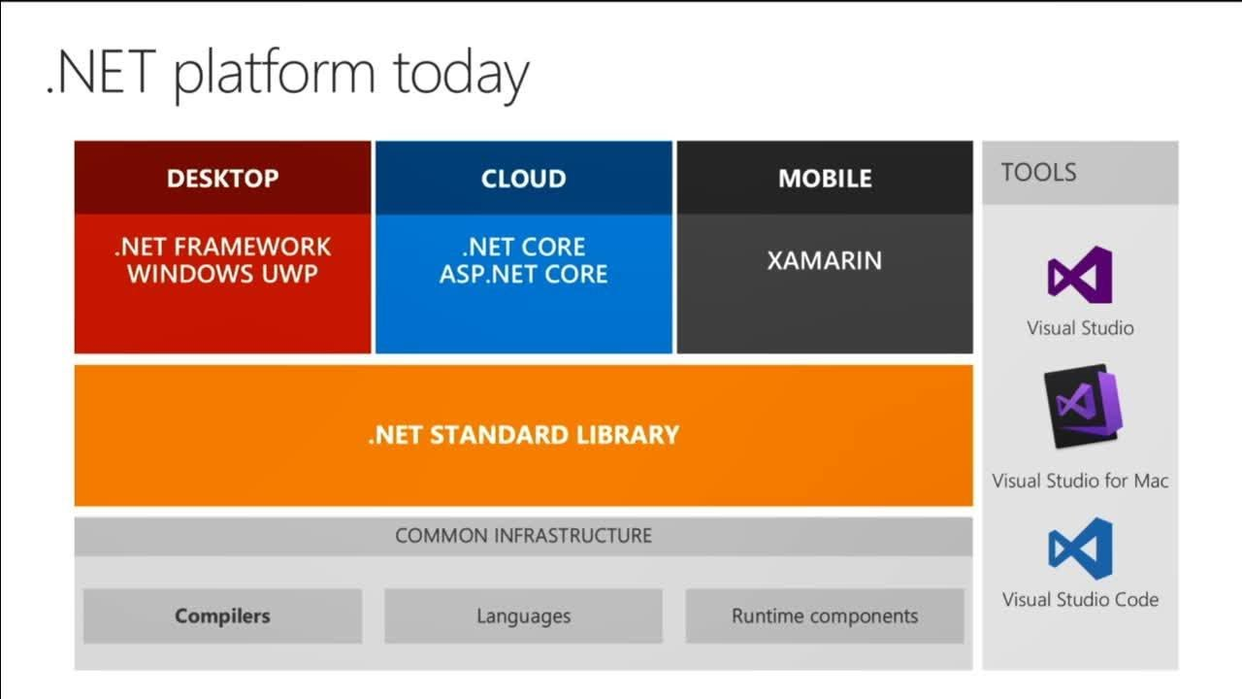

Slide 43








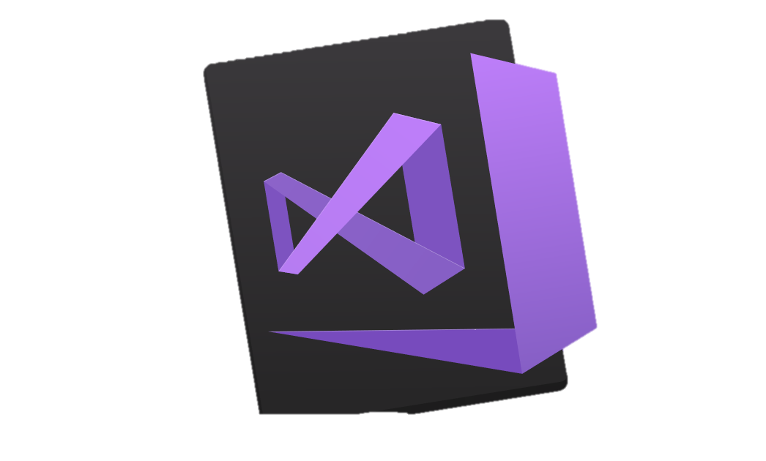


.NET – Una plataforma unificada
TOOLS
DESKTOP
WEB
CLOUD
MOBILE
GAMING
IoT
AI
VISUAL STUDIO
.NET STANDARD
VISUAL STUDIO FOR MAC
LIBRARIES
VISUAL STUDIO CODE
INFRASTRUCTURE
RUNTIME COMPONENTS
COMPILERS
LANGUAGES
COMMAND LINE INTERFACE

Slide 44
.NET Standard
.NET Standard es una especificación formal de las API de .NET que se prevé que estén disponibles en todas las implementaciones de .NET. La finalidad de .NET Standard es establecer una mayor uniformidad en el ecosistema de .NET.
.NET Standard habilita los escenarios clave siguientes:
Define un conjunto uniforme de API de BCL para todas las implementaciones de .NET que se van a implementar, independientemente de la carga de trabajo.
Permite a los desarrolladores generar bibliotecas portátiles que se pueden usar en las implementaciones de .NET con este mismo conjunto de API.
Reduce o incluso elimina la compilación condicional de código fuente compartido debido a las API de .NET, solo para API de sistema operativo.

Slide 45
¿Que hay en .NET Standard?
https://blog.xamarin.com/history-dot-net-standard/

Slide 46
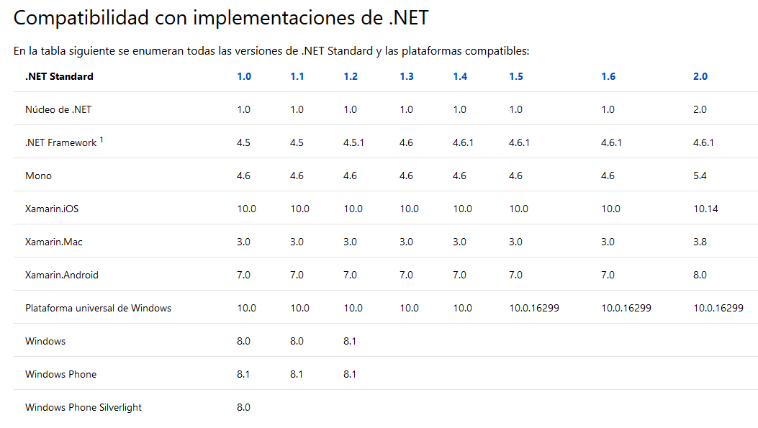
.NET Standard

Slide 47
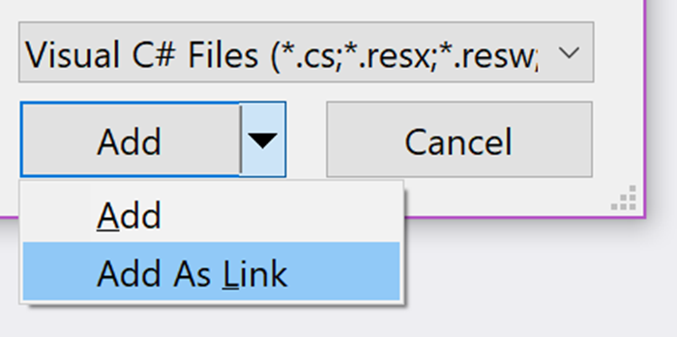
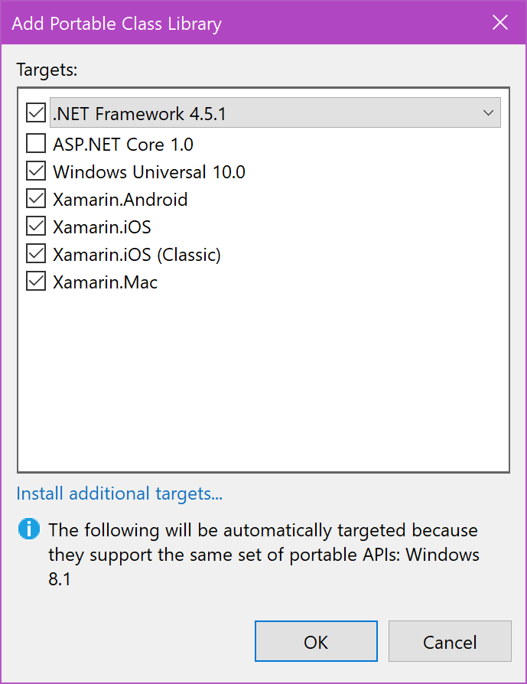
SHARED PROJECTS vs PCL vs NET STANDARD
Shared Projects o Add as link
Portable Class Library (PCL)
Notes:
History of .NET Standard
In the early days of the .NET framework, there was little need to share code between applications. When Windows Presentation Foundation (WPF) was released in 2006, it was a choice between WinForms or WPF, and developers didn’t have to support the same application in both frameworks. Though sharing files was sometimes needed between client and server apps, it was infrequent.
Microsoft then released Silverlight, a smaller, portable framework on Windows, Mac OS, and Linux. Suddenly, developers were asked to code two versions of the same application: a full-featured version made in WPF to only run in Windows and a smaller version that ran cross-platform in Silverlight. The Silverlight plugin was able to run these apps outside of the browser (OOB) which made it possible to build cross-platform applications. There was even some hope that Silverlight would eventually run on mobile phones. Though this never came to be, the need to have the same code run on multiple platforms became more crucial and more complex.
Add As Link
To add a class to both a Windows Presentation Foundation and a Silverlight application, one would have to Add As Link. To do this in Visual Studio, add the actual file to one of the two applications. For example, here’s how to add it to WPF:
Right-click on the other project.
Select Add Existing Item (Will open the corresponding dialog.)
Navigate to the location of the original file and select it.
Open the combo box located in the Add button.
Then Add As Link (Creates a shortcut to the original file.)
After the file has been added as a link, it shows up in the Solution Explorer with a small blue arrow. If you browse to the folder, you’ll see the file is not physically present. Visual Studio added a Link item to the project file, for instance:
1
2
3
<Compile Include="..\SharedFiles\ViewModel\MainViewModel.cs">
<Link>ViewModel\MainViewModel.cs</Link>
</Compile>
Today, Add As Link still has utility, as when sharing images between applications. In Xamarin.Forms, you have the possibility to create a project using a Shared Project to share your source files. Under the cover, Visual Studio is using the same shortcuts shown above.
A Xamarin.Forms application with a Shared project
Portable Class Libraries (PCL)
The maintenance of shared files can be challenging. Every time a new class is added, links to that file also need to be added to every application. With that in mind, in 2011 Microsoft released a new type of class libraries called Portable Class Libraries. A project type that creates a binary file compatible with multiple frameworks.
Creating a new Portable Class Library
The available APIs are reduced each time a new target framework is selected. For example, if a class is available in .NET Framework 4.5.1 but not in Windows Universal 10.0, it won’t be available in the PCL targeting both these frameworks. The combinations of the target frameworks is called a Profile.
While PCLs were a breakthrough at the time of their creation, it was sometimes difficult to find information on which APIs were available and where to find them. In time, it became clear to the .NET team that a simpler approach was needed.

Slide 48
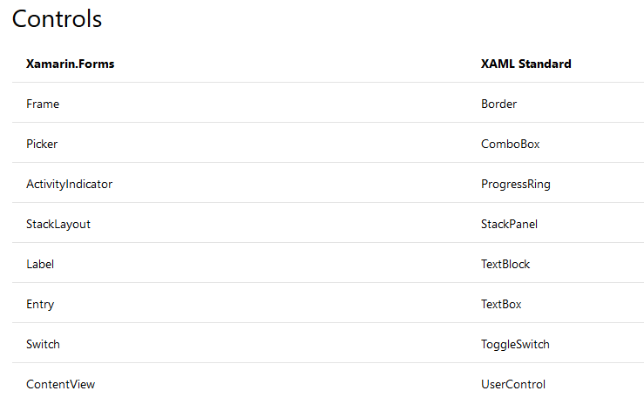
Xaml Standard

Slide 49
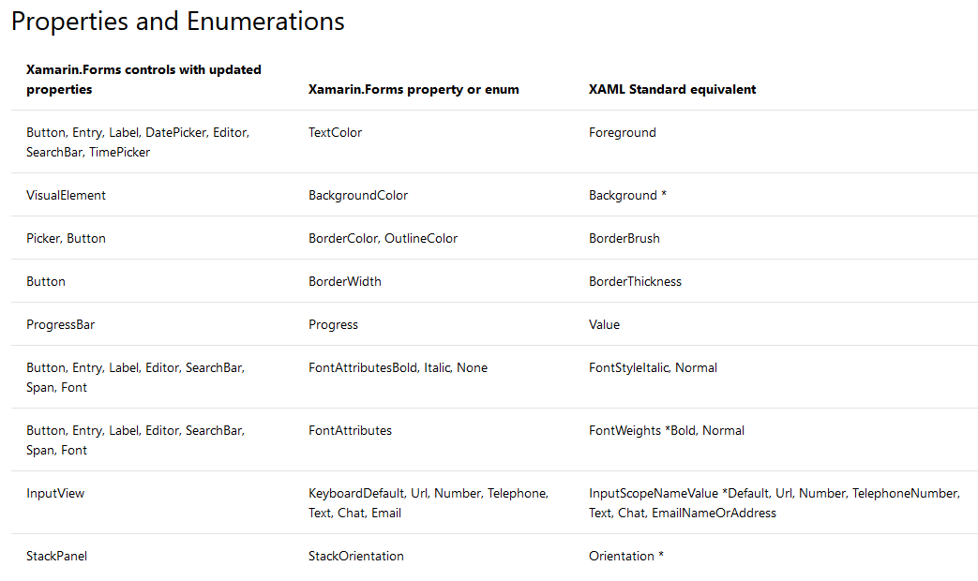
Xaml Standard

Slide 50
¿QUÉ NECESITAMOS PARA EMPEZAR?
¿Qué tienes?
¿Para qué plataforma?
Windows
Visual Studio Community (Gratis)
Mac
Visual Studio para Mac (Gratis)
Windows virtualizado con Parallels
Mac/iOS
Mac
Windows
Windows
Linux/Android
Mac ó
Windows

Slide 51
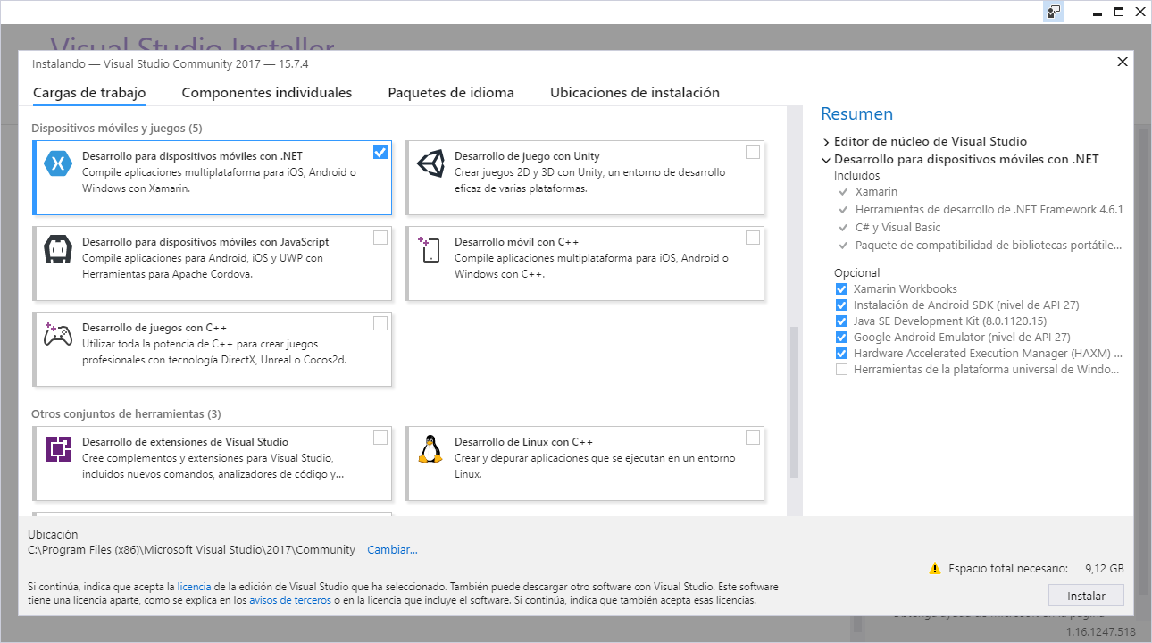
Instalador VS Community

Slide 52
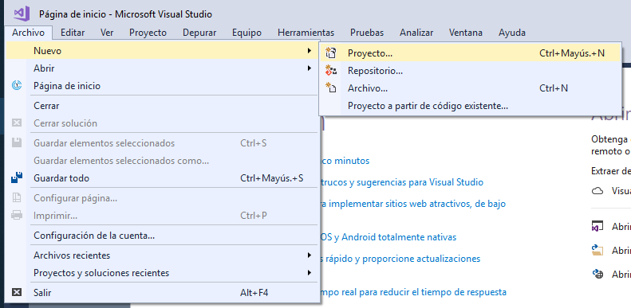
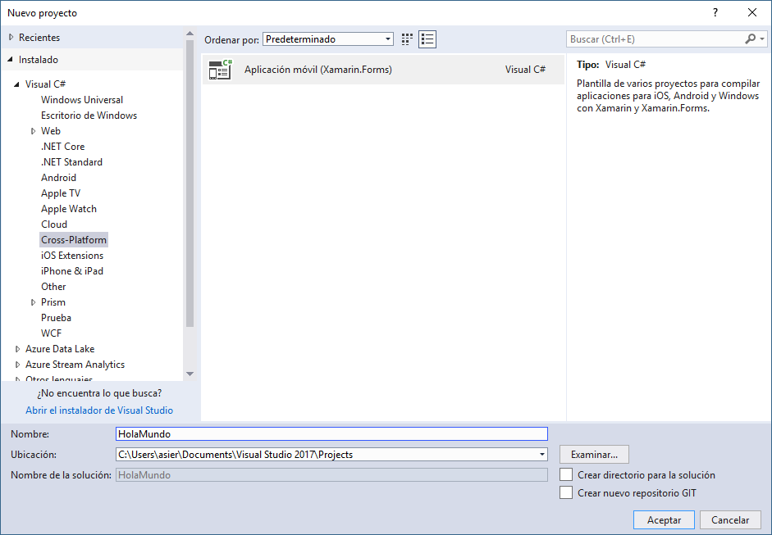
Visual Studio. Xamarin Forms

Slide 53
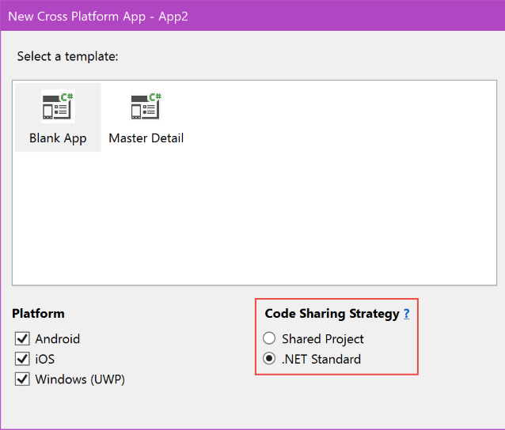

Slide 54
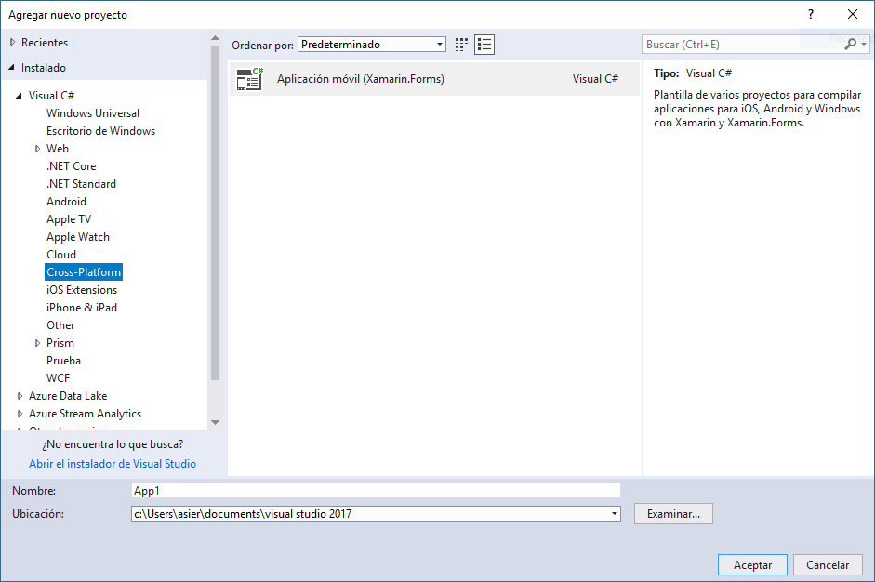
TIPOS DE PROYECTOS. PLANTILLAS POR DEFECTO

Slide 55
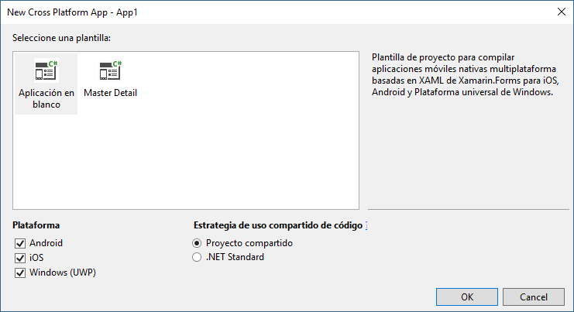
TIPOS DE PROYECTOS. PLANTILLAS POR DEFECTO

Slide 56
Taller. ¡Empezamos!
Talk is cheap. Show me the code

Slide 57
Xamarin + Xamarin.Forms
iOS C# UI
Android C# UI
Windows C# UI
Xamarin.Forms
Lógica compartida C#
Lógica compartida C#
Aproximación Xamarin Tradicional
Con Xamarin.Forms: Más código compartido, todo nativo

Slide 58
Nuevas Plataformas
Xamarin Forms Everywhere!

Slide 59


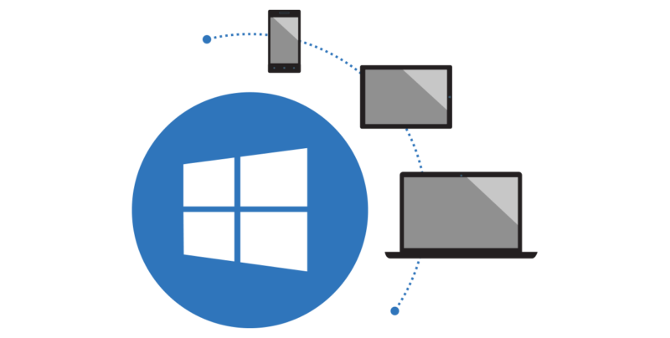
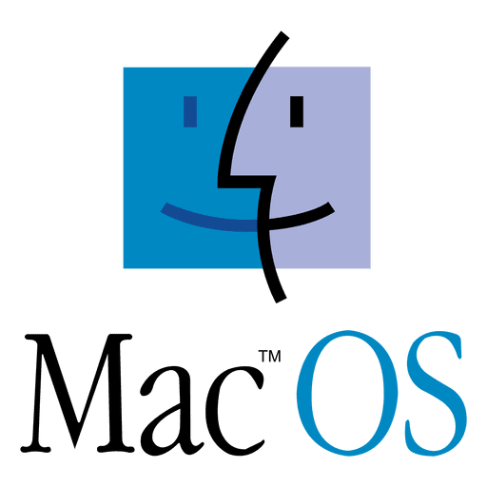
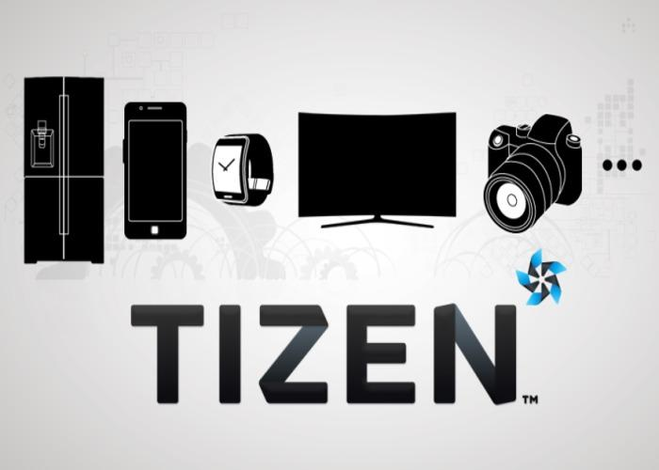
Disponibles ya
UWP

Slide 60
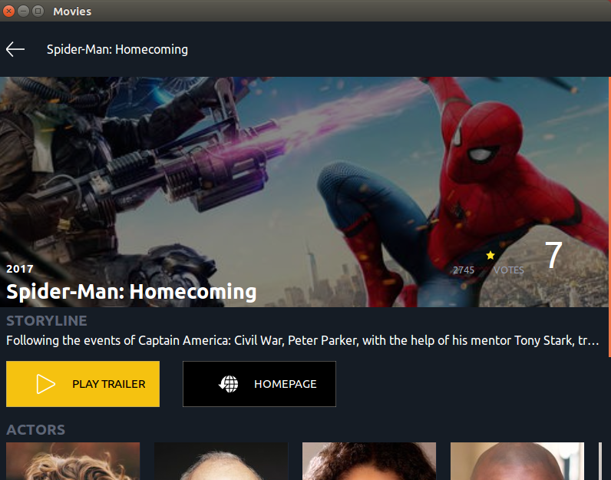
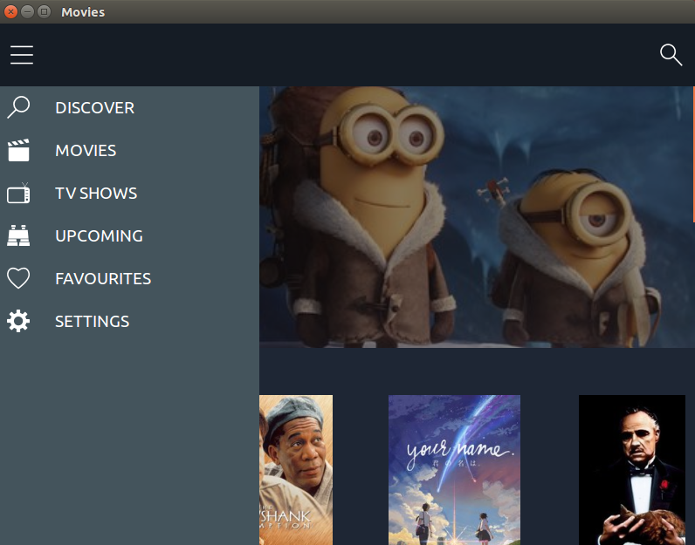
Linux. Con GTK
Github Javier Suarez

Slide 61
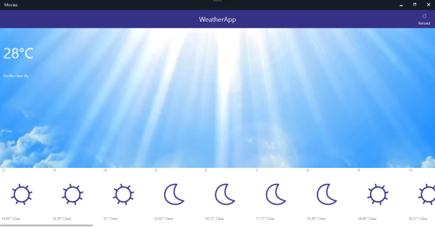
WPF

Slide 62
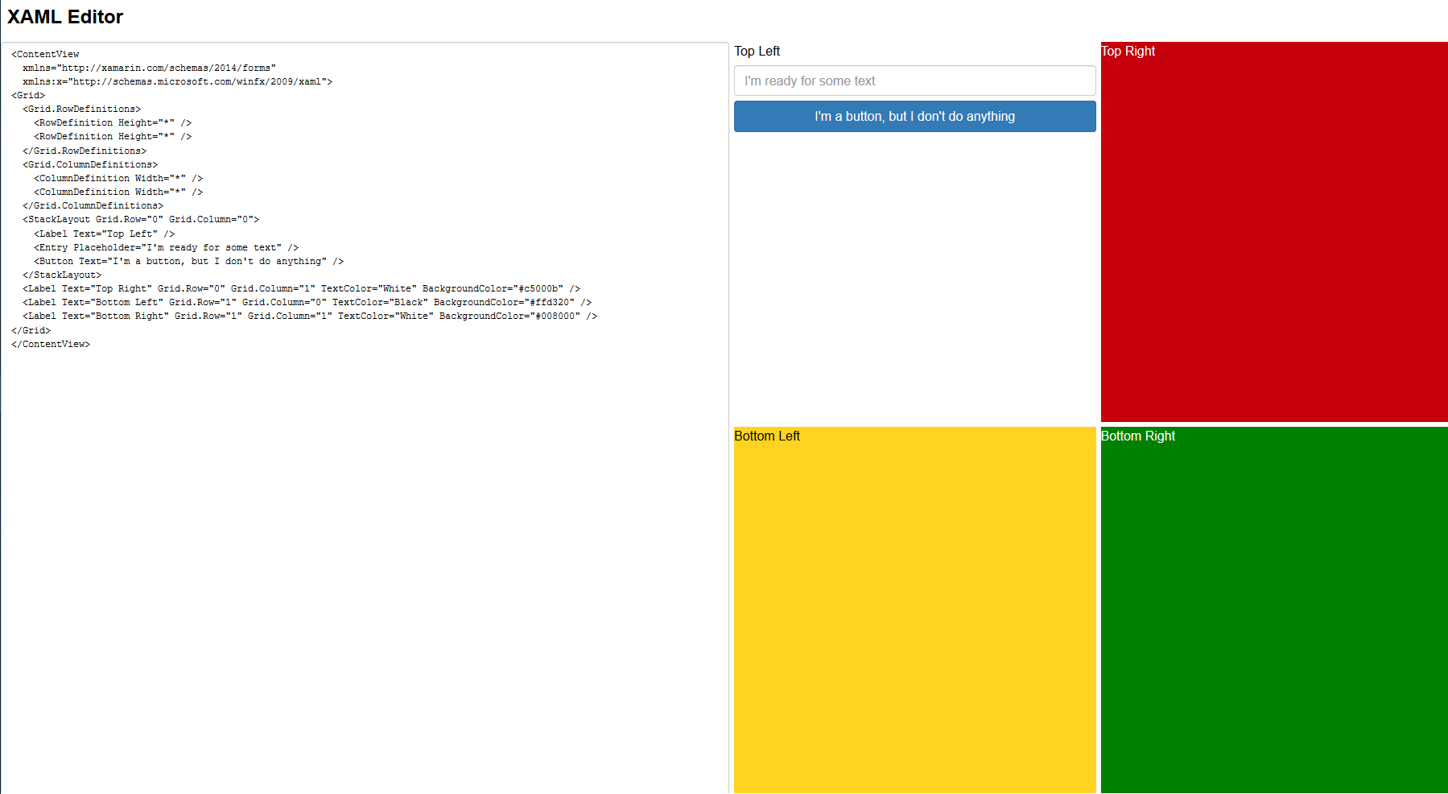
Ouii. Web
https://s3.amazonaws.com/praeclarum.org/wasm/index.html

Slide 63
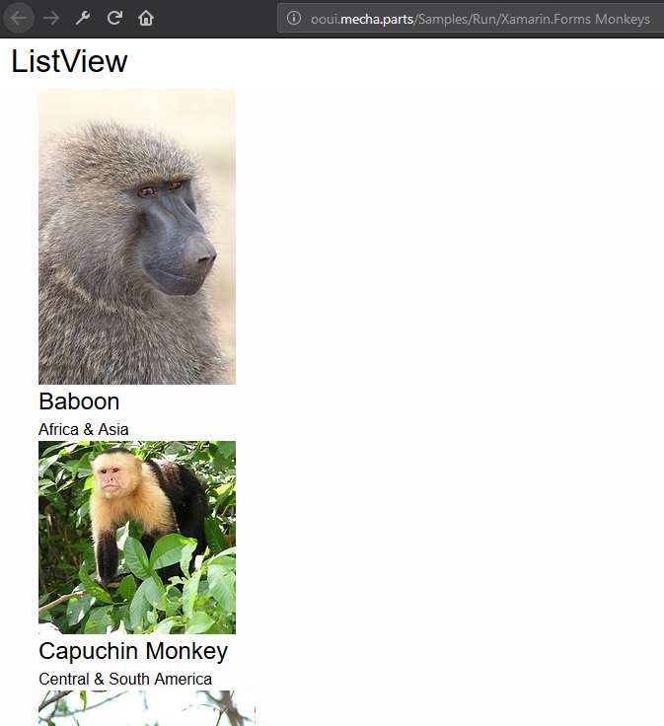
Ouii. Web
https://github.com/praeclarum/Ooui
ooui.mecha.parts

Slide 64
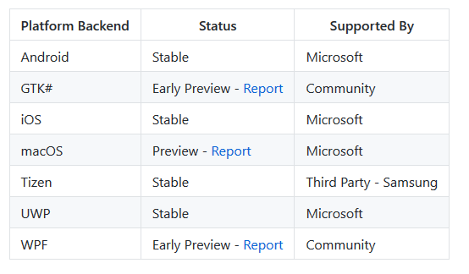
Resumen plataformas
https://github.com/xamarin/Xamarin.Forms/wiki/Platform-Support

Slide 65
Previsualizar código UI
Xamarin Forms Previewer, Xamarin Live Player, Live Reload

Slide 66
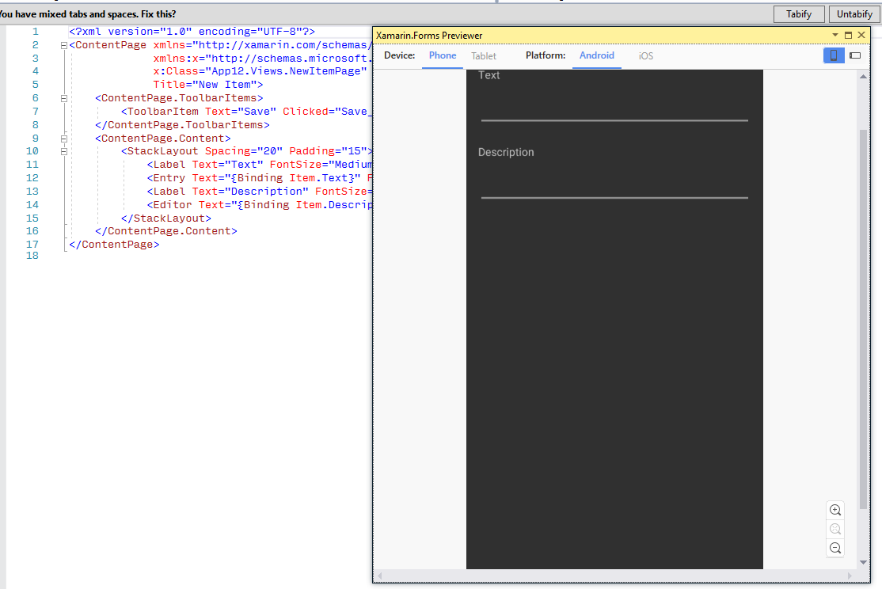
Xamarin Forms Previewer

Slide 67
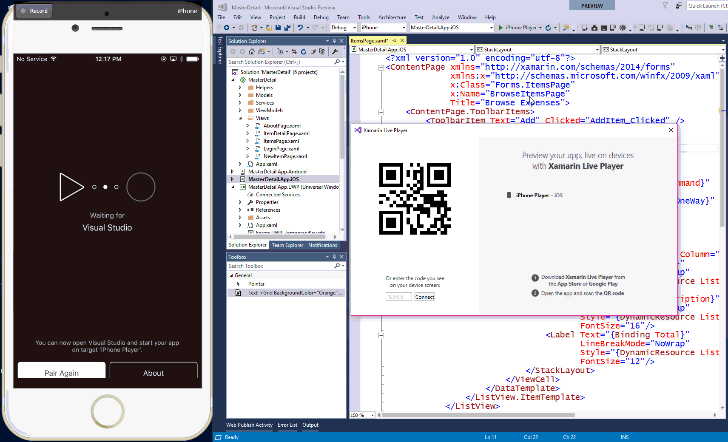
Xamarin Live Player

Slide 68
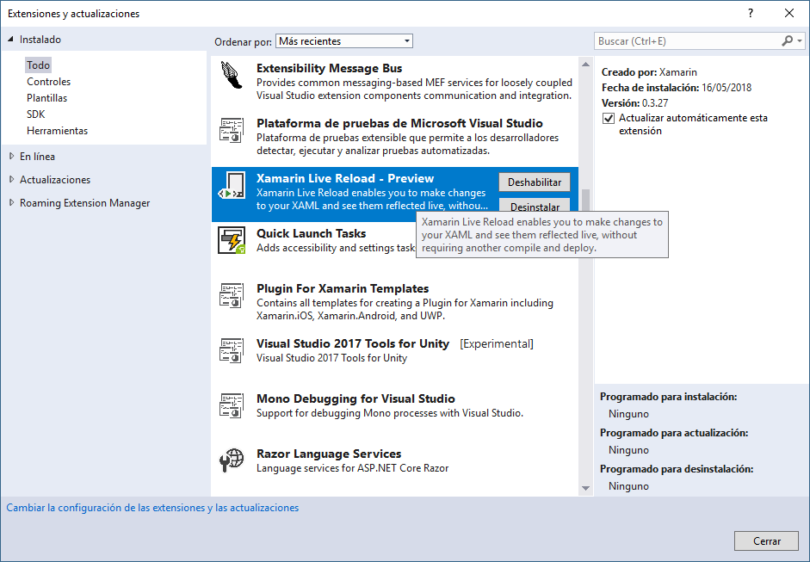
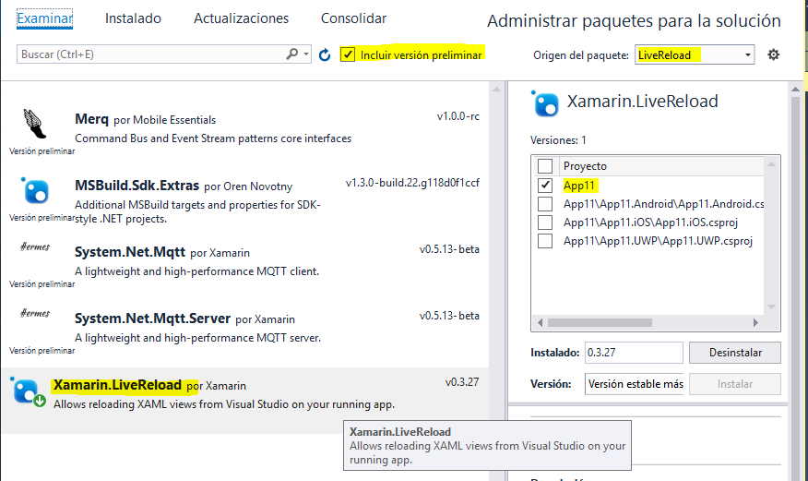
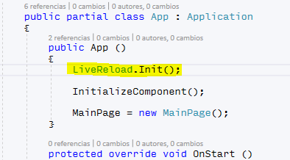
Live Reload

Slide 69
Xamarin Live Reload
Página documentación: https://docs.microsoft.com/es-es/xamarin/xamarin-forms/xaml/live-reload
Pasos:
Descargar extensión e instalar (cerrar VS si está abierto)
Abrir el proyecto de VS que queramos probar
Ir a “Adminstrar paquetes NuGet para la solución…” (botón derecho en la solución, ventana Explorador de soluciones)
Marcar el check “Incluir versión preliminar”
Buscar el paquete Xamarin.LiveReload
Instalarlo en el proyecto compartido (Net Standard)
Inicializar el paquete en el fichero App.Xaml.cs (añadir la siguiente línea al principio del constructor)
LiveReload.Init();

Slide 70
XAML

Slide 71
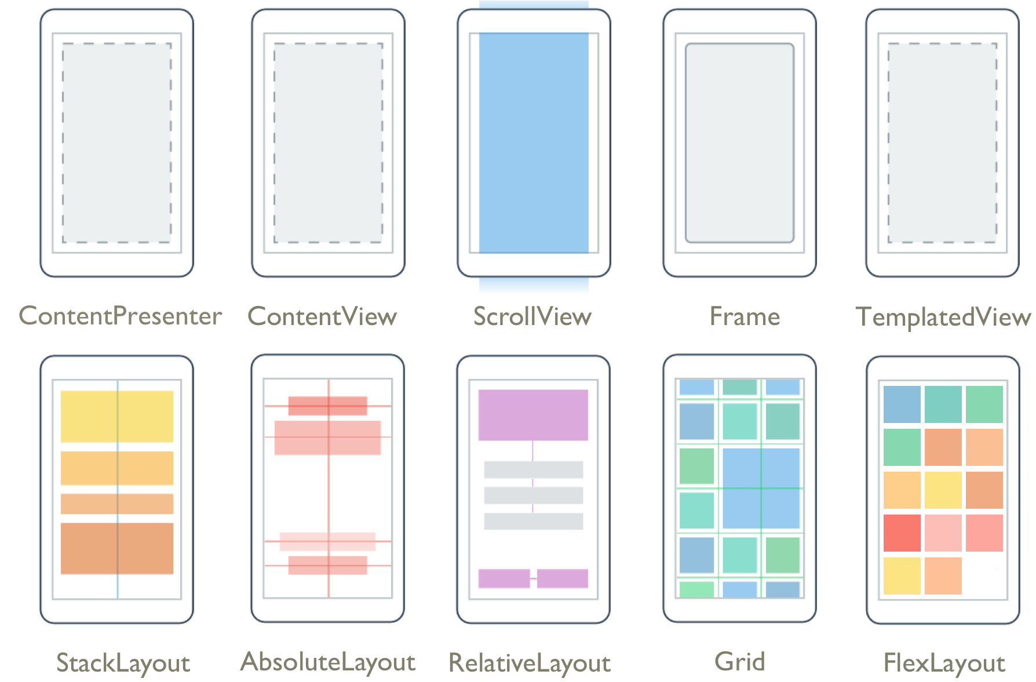
XAML. Layouts

Slide 72
XAML. Layouts
Diseño con un único elemento hijo
ContentPresenter
ContentView
ScrollView
Frame
TemplatedView
Diseño con varios elementos hijos
AbsoluteLayout
RelativeLayout
Grid
StackLayout
FlexLayout

Slide 73
Controles

Slide 74
Controles
ActivityIndicator
BoxView
Button
DatePicker
Editor
Entry
Image
Label
ListView
Map
OpenGLView
Picker
ProgressBar
SearchBar
Slider
Stepper
TableView
TimePicker
WebView
EntryCell
ImageCell
SwitchCell
TextCell
ViewCell
CollectionView

Slide 75
Binding / Enlace a datos

Slide 76
Binding / Enlace de datos
Los enlaces de datos conectan las propiedades de dos objetos, llamados el origen (source) y el destino (target).
Se requieren dos pasos:
La propiedad BindingContext del objeto de destino debe asignarse al objeto de origen. Cada objeto sólo puede tener un BindingContext
y el método SetBinding (utilizado a menudo junto con la clase Binding) debe llamarse en el objeto de destino para vincular una propiedad de ese objeto a una propiedad del objeto de origen.
La propiedad destino debe ser una propiedad enlazable, lo que significa que el objeto destino debe derivar de BindableObject.
BindingContext se propaga

Slide 77
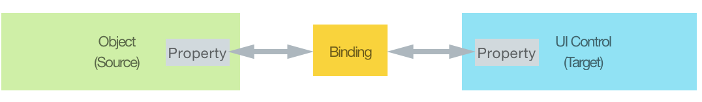

Slide 78
<ContentPage xmlns="http://xamarin.com/schemas/2014/forms"
xmlns:x="http://schemas.microsoft.com/winfx/2009/xaml"
x:Class="XamlSamples.SliderBindingsPage"
Title="Slider Bindings Page">
<StackLayout>
<Label Text="ROTATION"
BindingContext="{x:Reference Name=slider}"
Rotation="{Binding Path=Value}"
FontAttributes="Bold"
FontSize="Large"
HorizontalOptions="Center"
VerticalOptions="CenterAndExpand" />
<Slider x:Name="slider"
Maximum="360"
VerticalOptions="CenterAndExpand" />
<Label BindingContext="{x:Reference slider}"
Text="{Binding Value, StringFormat='The angle is {0:F0} degrees'}"
FontAttributes="Bold"
FontSize="Large"
HorizontalOptions="Center"
VerticalOptions="CenterAndExpand" />
</StackLayout>
</ContentPage>

Slide 79
Modos
Los modos de enlace de datos son:
Default
OneWay — los valores son transferidos desde el origen al destino
OneWayToSource — los valores son transferidos desde el destino al origen
OneTime – los valores son tranferidos desde el origen al destino, pero solo una vez
TwoWay — los valores son transferidos en ambos sentidos

Slide 80
MVVM
Modelo - Vista - Vista Modelo

Slide 81
MVVM
Siglas de Modelo-Vista-Vista Modelo
Patrón de arquitectura que nos ayuda a separar la lógica de negocio de la interfaz de usuario
Mantener una separación limpia entre la lógica de la aplicación y la interfaz de usuario ayuda a abordar numerosos problemas de desarrollo y puede hacer que una aplicación sea más fácil de probar, mantener y evolucionar.
También puede mejorar enormemente las oportunidades de reutilización de código y permite a los desarrolladores y diseñadores de interfaces de usuario colaborar más fácilmente a la hora de desarrollar sus respectivas partes de una aplicación.
Nació con WPF (2008). Utilizado en WPF, Silverlight, Windows Phone y UWP

Slide 82
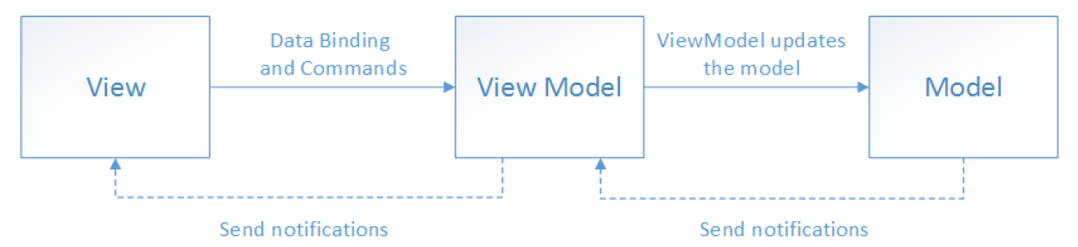
La vista "conoce" el view-model y el view-model "conoce" el modelo, pero el modelo no conoce el view-model y el view-model no conoce la vista.
Por lo tanto, el view-model aísla la vista del modelo y permite que el modelo evolucione independientemente de la vista.

Slide 83
MVVM. Ventajas
Los desarrolladores pueden crear pruebas unitarias para el view-model y el modelo, sin usar la vista. Las pruebas unitarias para el view-model pueden ejercer exactamente la misma funcionalidad que la utilizada por la vista.
La interfaz de usuario de la aplicación se puede rediseñar sin tocar el código, siempre que la vista se implemente completamente en XAML. Por lo tanto, una nueva versión de la vista debería funcionar con el view-model existente.
Los diseñadores y desarrolladores pueden trabajar de forma independiente y simultánea en sus componentes durante el proceso de desarrollo. Los diseñadores pueden centrarse en la vista, mientras que los desarrolladores pueden trabajar en el view-model y los componentes del modelo.

Slide 84
Notificación de propiedades
Para que el view model participe en el enlace bidireccional de datos con la vista, sus propiedades deben lanzar el evento PropertyChanged. Los view-models satisfacen este requisito implementando la interfaz INotifyPropertyChanged y lanzando el evento PropertyChanged cuando se cambia una propiedad.
Para las colecciones, se proporciona el ObservableCollection<T> de fácil visualización. Esta colección implementa la notificación de cambios en la colección, liberando al desarrollador de la necesidad de implementar la interfaz INotifyCollectionChanged en las colecciones.

Slide 85
INotifyPropertyChanged
namespace System.ComponentModel
{
//
// Resumen:
// Notifies clients that a property value has changed.
public interface INotifyPropertyChanged
{
//
// Resumen:
// Occurs when a property value changes.
event PropertyChangedEventHandler PropertyChanged;
}
}

Slide 86
Ejemplo
public class MainViewModel : INotifyPropertyChanged
{
public event PropertyChangedEventHandler PropertyChanged;
private Semaphore _semaphore1;
public Semaphore Semaphore1
{
get => _semaphore1;
set
{
_semaphore1 = value;
if (PropertyChanged!=null)
{
PropertyChanged(this, new PropertyChangedEventArgs(nameof(Semaphore1)));
}
}
}
}

Slide 87
COMANDOS
En las aplicaciones móviles, las acciones suelen invocarse en respuesta a una acción del usuario, como un clic en un botón, que puede implementarse creando un gestor de eventos en el code-behind.
Sin embargo, en el patrón MVVM, la responsabilidad de implementar la acción recae en el view model, y debe evitarse colocar el código en el code-behind.
Los comandos proporcionan una forma conveniente de representar acciones que pueden estar vinculadas a controles en la interfaz de usuario. Encapsulan el código que implementa la acción y ayudan a mantenerla desacoplada de su representación visual en la vista.
Xamarin.Forms incluye controles que pueden ser conectados declarativamente a un comando, y estos controles invocarán el comando cuando el usuario interactúe con el control.

Slide 88
COMANDOS
Los View-Models normalmente exponen los comandos como propiedades, enlazables desde la vista a través de la interfaz ICommand
Varios controles de Xamarin Forms proporcionan una propiedad Command, que pueden ser enlazadas a través de un objeto ICommand
VIEWMODEL
public ICommand RefreshCommand => new Command(OnRefreshCommand);
private async void OnRefreshCommand()
{
await LoadData();
}
VIEW
<Button Text="Refresh" Command="{Binding RefreshCommand}"/>

Slide 89
Novedades versión (4.0)
Shell, Vision, CollectionView

Slide 90
SHELL
Xamarin.Forms Shell es un contenedor para aplicaciones que proporciona características fundamentales de la interfaz de usuario que requieren la mayoría de las aplicaciones, lo que le permite centrarse en la carga de trabajo principal de la aplicación. Las aplicaciones de Shell se ofrecen con la siguiente funcionalidad:
Un único lugar para describir la estructura visual de una aplicación.
Una interfaz de usuario de navegación común.
Un servicio de navegación con enlaces profundos (Deep links).
Un gestor de búsqueda integrado.
https://docs.microsoft.com/es-es/xamarin/xamarin-forms/app-fundamentals/shell

Slide 91
Ejemplos Shell (Android)
Varias de las diapositivas de Shell son de Javier Suarez

Slide 92
Y en iOS

Slide 93
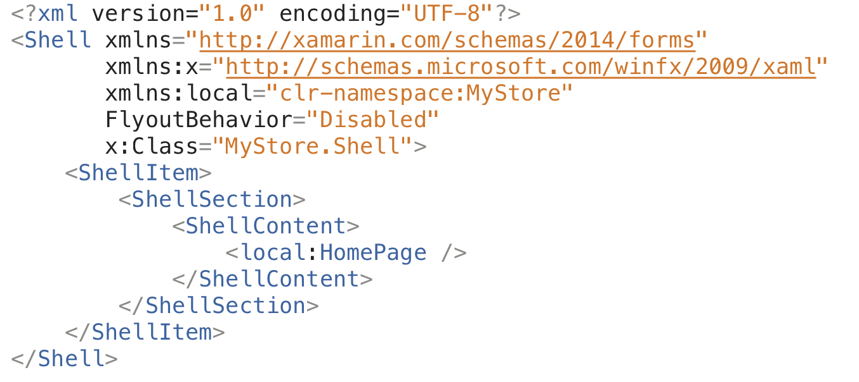
Xamarin.Forms Shell

Slide 94
Xamarin.Forms Shell
<Shell xmlns="http://xamarin.com/schemas/2014/forms"
xmlns:x="http://schemas.microsoft.com/winfx/2009/xaml"
x:Class="TestTaller1.TheShell"
xmlns:local="clr-namespace:TestTaller1.Views“
Title="Todo App UR-Rioja{dotnet}"
RouteHost="companyname.com“ RouteScheme="app“ Route="TallerShell">
<Shell.FlyoutHeader>
<controls:FlyoutCustom/>
</Shell.FlyoutHeader>
<ShellItem Title="Browse" Icon="tab_feed.png">
<ShellSection>
<ShellContent ContentTemplate="{DataTemplate local:ItemsPage}"/>
</ShellSection>
</ShellItem>
<ShellItem Title="About" Icon="tab_about.png">
<ShellSection>
<ShellContent ContentTemplate="{DataTemplate local:AboutPage}"/>
</ShellSection>
</ShellItem>
</Shell>

Slide 96
Navegación
Llegan grandes novedades con Shell

Slide 97
Navegación
Shell introduce un nuevo modelo de navegación basado en URI.
El sistema de URI permiten una navegación mejorada, ya que podemos saltar instantáneamente a cualquier parte de la aplicación e incluso ofrecer la posibilidad de retroceder sin tener que crear todas las páginas entre los dos puntos.

Slide 98
Navegación
Lo primero que debemos hacer es declarar nuestras rutas, comenzando con el esquema y el host de nuestra aplicación.
Al juntar estas piezas en una URL, terminamos con el siguiente URI: "app: //www.microsoft.com/myapp". Cada elemento Shell que hemos definido también toma una propiedad de ruta que luego podemos usar para navegar programáticamente. Para las páginas que no están representadas por un elemento Shell, podemos registrar explícitamente una ruta.
<Shell
Route="myapp"
RouteHost="www.microsoft.com"
RouteScheme="app"

Slide 99
Navegación
En el constructor de Shell.cs, o en cualquier lugar que se ejecute antes de que llamemos a la ruta, podemos declarar las rutas necesarias.
Routing.RegisterRoute("products", typeof(ProductsView));
(App.Current.MainPage as Xamarin.Forms.Shell)
.GoToAsync($"app:///myapp/products?id={productId}", true);

Slide 100
Navegación
(App.Current.MainPage as Xamarin.Forms.Shell).GoToAsync($"app:///myapp/products?id={productId}", true);
Otra gran ventaja de Shell es que cuenta con métodos de navegación estática a los que se puede acceder desde cualquier lugar de la aplicación. Podemos obtener una referencia al Shell de la aplicación que es la página principal de su aplicación accesible como una propiedad estática desde App.Current .
Para realizar la navegación, utilizamos al método GoToAsync () pasando una URL válida como un ShellNavigationState. Un ShellNavigationState puede construirse a partir de una cadena o un URI.

Slide 101
Interceptar la navegación atrás
Esta ha sido una gran solicitud y algo que ha sido difícil de manejar en Xamarin.Forms.
Ahora, podemos capturar la navegación antes y después de que se haya completado para implementar código personalizado.
<Shell …
Navigating="Shell_Navigating"
private void Shell_Navigating(object sender, ShellNavigatingEventArgs e)
{
if (//some Boolean evaluation)
{
e.Cancel(); // do not allow this navigation AND/OR do something else
}
}

Slide 102
ShellNavigatingEventArgs
Elemento | Tipo | Descripción
Current | ShellNavigationState | La URI de la página actual.
Source | ShellNavigationState | La URI que representa de donde se ha originado la navegación.
Target | ShellNavigationState | La URI que representa hacia donde se navegará.
CanCancel | Boolean | Propiedad que indica si la navegación se puede cancelar.
Cancel | Boolean | Método para cancelar la navegación requerida.
Canceled | Boolean | Propiedad que indica si la navegación ha sido cancelada.

Slide 103
La barra de navegación
Shell está enfocado en facilitar las cosas, y la barra de navegación es uno de los controles nativos más difíciles de personalizar en las plataformas móviles. Las personalizaciones comunes incluyen la capacidad de agregar imágenes personalizadas para el botón Atrás o para agregar contenido personalizado al espacio de título y el comportamiento de búsqueda plegable.
<Shell.TitleView>
<StackLayout>
<Image Margin="10,0,0,0" Source="gear"/>
</StackLayout>
</Shell.TitleView>

Slide 104
La barra de navegación: búsqueda
Es un patrón común integrar un campo de búsqueda en la barra de navegación y, en algunos casos, incluso tenerlo dentro y fuera de ese espacio. Shell presenta SearchHandler que contiene toda la lógica de búsqueda de ContentPage, así como el comportamiento deseado de la UI. SearchHandler expone SearchBoxVisibility para controlar el estado de la interfaz de usuario y otras propiedades.
Collapsable
Expanded
Hidden
IsSearchEnabled
ShowResults
Placeholder

Slide 105
Visuals
Facilitar conseguir misma UI en diferentes plataformas

Slide 106
Drawing Spec
Actualmente, muchas aplicaciones se ven a nivel estético exactamente igual en todas las plataformas. En Xamarin.Forms, para conseguir este resultado, en ocasiones hacen falta Custom Renders o efectos (código específico de plataforma) para conseguirlo.
Por ese motivo, junto a Shell llega una nueva opción para conseguir la misma interfaz de usuario en diferentes plataformas sin necesidad de requerir tanto a Custom Renders o efectos.

Slide 107
MaterialShell
MaterialShell consigue mantener utilizando controls 100% nativos pero aplicando interfaz Material en Android e iOS.
Para comenzar a utilizarlo, es necesario establecer el flag, Visual_Experimental antes de inicializar Forms.
global::Xamarin.Forms.Forms.SetFlags("Visual_Experimental");

Slide 108
MaterialShell
Contamos con una nueva propiedad, Visual, disponible en ContentPage para establecer que usaremos un dibujado específico en todas las plataforButton
En la preview, a parte de la ContentPage tenemos la propiedad Visual en:
Button
Entry
Frame
ProgressBar
<ContentPage xmlns="http://xamarin.com/schemas/2014/forms"
Visual="Material"
Title="Visual Material">

Slide 109
CollectionView
Más opciones, rendimiento y personalización con colecciones

Slide 110
CollectionView
Su objetivo es proporcionar una forma más flexible y una alternativa de alto rendimiento a ListView. Ambas, CollectionView y ListView son similares, existen pero tienenalgunas diferencias importantes:
CollectionView no tiene ningún concepto de celdas. En su lugar, las plantillas de datos se usan para definir la apariencia de cada elemento de datos en la lista.
CollectionView reduce la API de ListView. Muchas propiedades y eventos de ListView no están presentes en CollectionView.
CollectionView tiene un modelo de diseño flexible que permite que los datos se presentan vertical u horizontalmente, en una lista o una cuadrícula.
https://docs.microsoft.com/es-es/xamarin/xamarin-forms/user-interface/collectionview

Slide 111
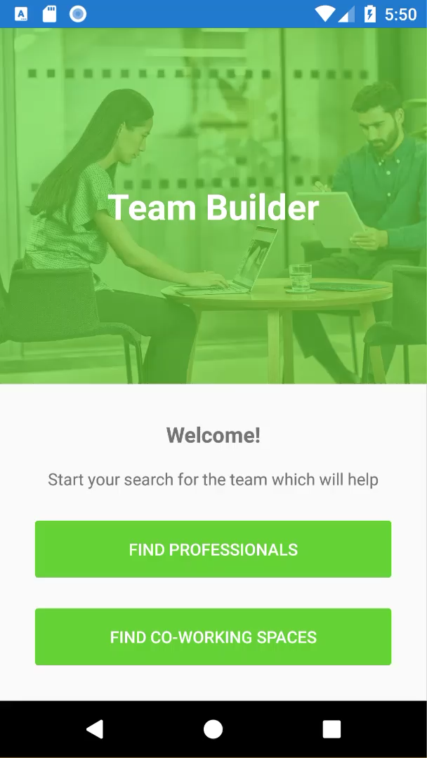
Grid

Slide 112

Carousel
Carousel

Slide 113
Recursos
Blogs:
James Montemagno: https://montemagno.com
Adam Pedley: https://xamarinhelp.com
Javier Suarez: https://javiersuarezruiz.wordpress.com
https://www.allaboutxamarin.com
Newsletter semanal: http://weeklyxamarin.com/
Vídeos:
Build 2018
Píldoras DevsDNA
Dotnet2018
The Xamarin Show
Documentación oficial:
https://docs.microsoft.com/es-es/xamarin/xamarin-forms/
https://blog.xamarin.com
https://university.xamarin.com
Foro Xamarin Forms

Slide 114
Recursos (II)
Código:
GoodLooking UI (Javier Suárez)
Awesome Xamarin Forms (Javier Suárez)
Código fuente Xamarin Forms
Xamarin Forms Samples
Repositorio James Montemagno
GitHub David Ortinau

Slide 115
¿Dudas?

Slide 116
¡Muchas gracias!
@AsierTarancon
asiertarancon@gmail.com
www.azkoyen.com
www.riojadotnet.com

Slide 117


